Slide 1
USB C Tester
Why?
USB C cables come in many different types
USB 2.0 Data only, Power Only, USB 3.0, USB 3.1, Sideband use, 60 Watt capable, 100 Watt capable, 240 Watt capable
USB C PD Power supplies come in many different types
Supporting wattages from 10W to 240W, Voltages from 5V to 20V, Currents up to 3A or up to 5A, some support arbitrary voltages while others only support a few specific voltages.
And, of course, cables can fail, or be miswired, as we’ve all dealt with in this class

Slide 2
USB C Tester
How?
My design has 2 main approaches:
It negotiates power delivery from a power supply to determine supported voltages and currents
It tests every signal pin in another cable, and indicates which are connected properly
An early concept diagram, showing the basic interface of the device, with 3 USB ports for testing, and lots of indicator LEDs

Slide 3
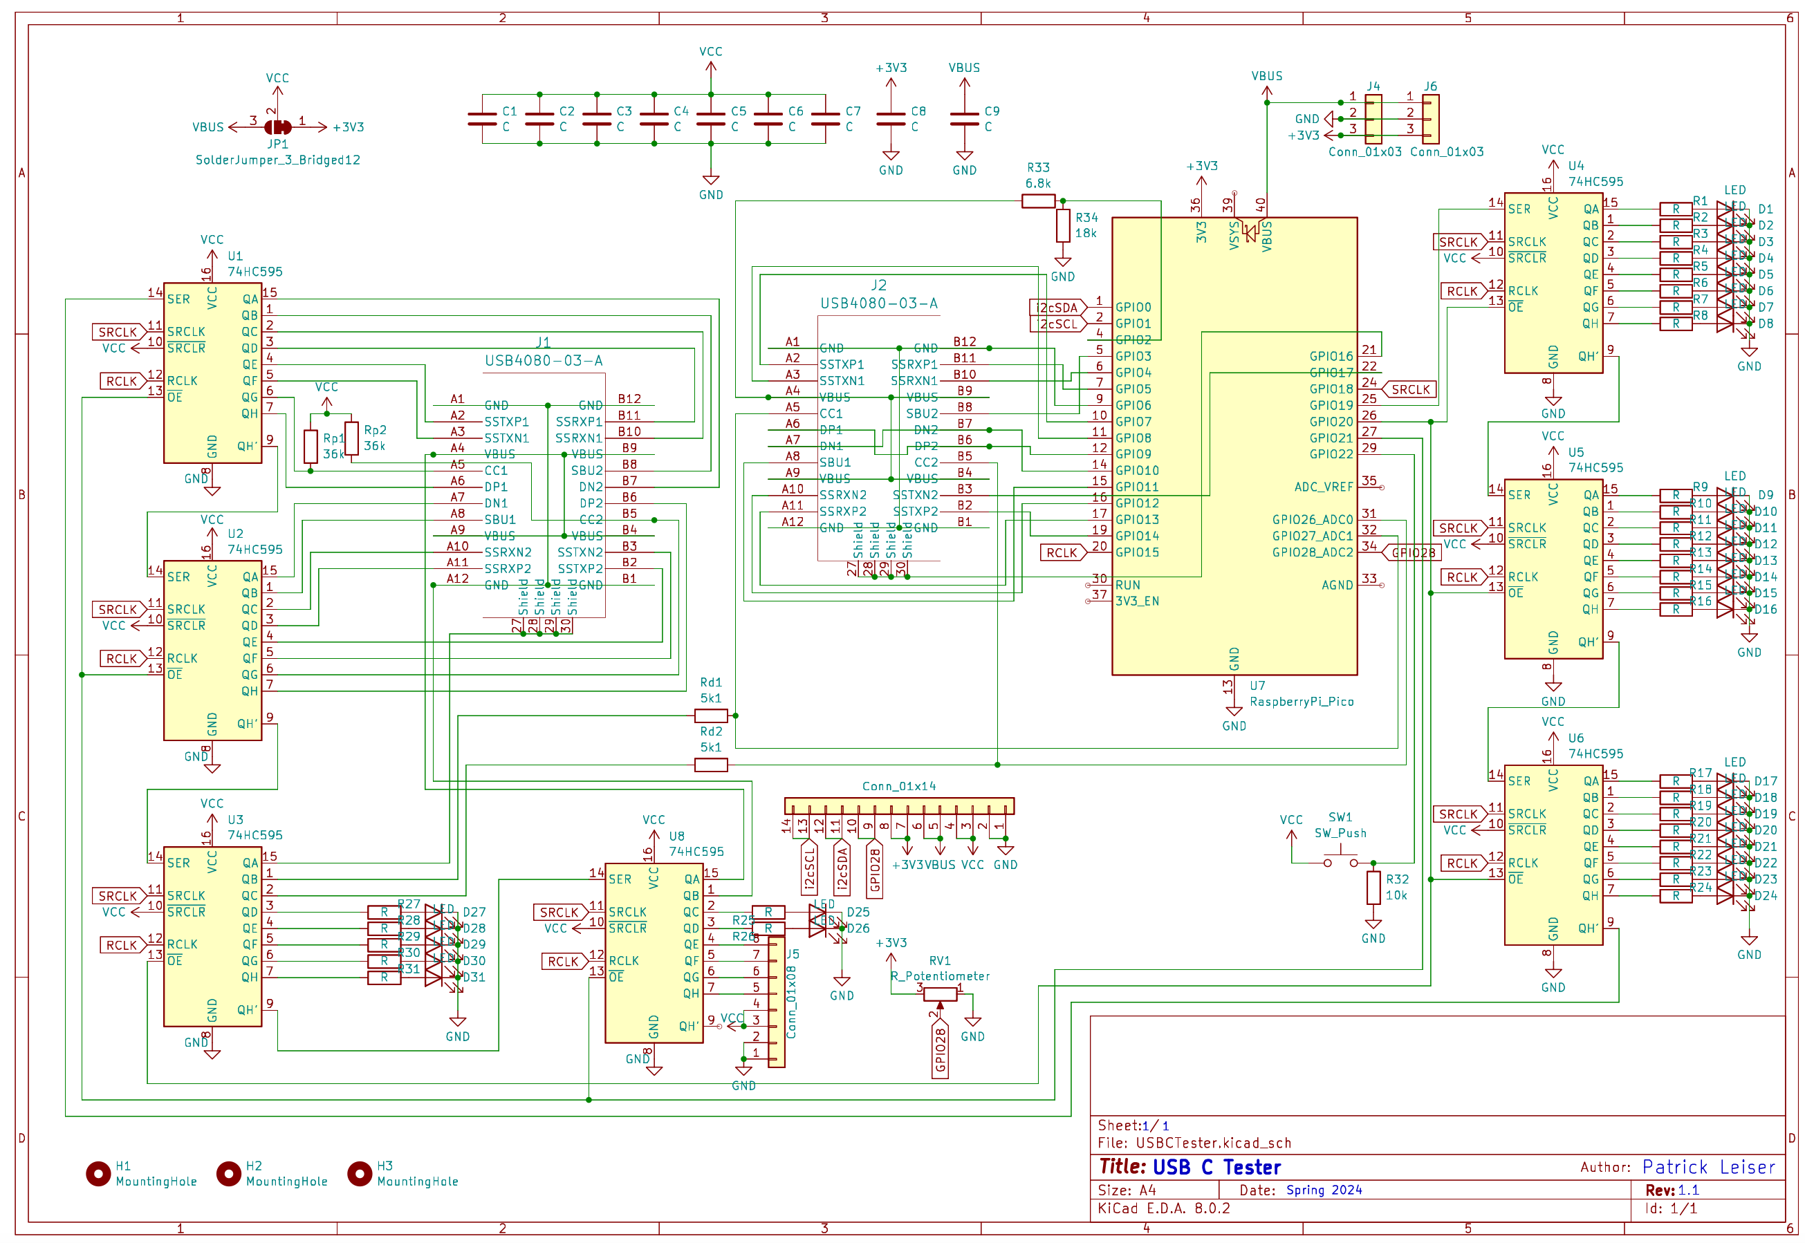
Designing
I designed the circuit in KiCad, using a variant of the Raspberry Pi Pico as the controller, and 6-7 shift registers for controlling all the needed output signals
See handout for more details on the hardware I chose and why I chose it

Slide 4
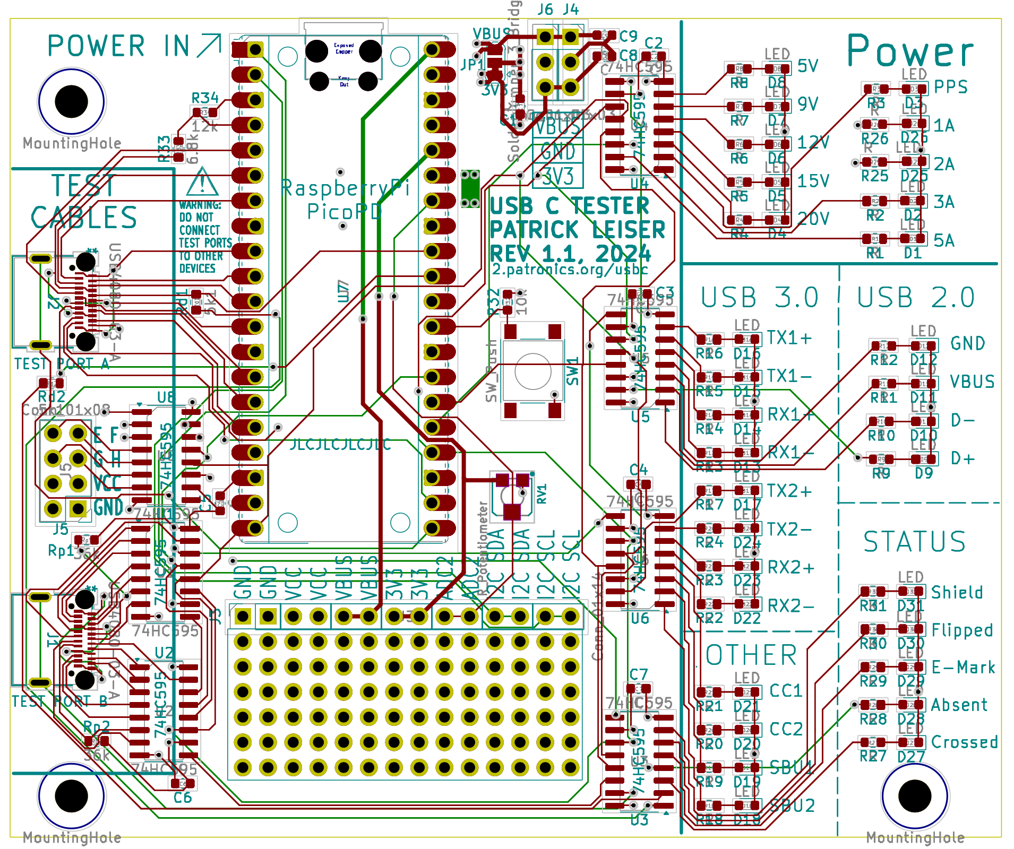
Designing - Part 2
As I adjusted the schematic, I also designed the physical circuit board.
I wanted to push myself to gain more experience with smaller surface-mount components, so used 0603 size (0.06 by 0.03 inch) components when possible

Slide 5
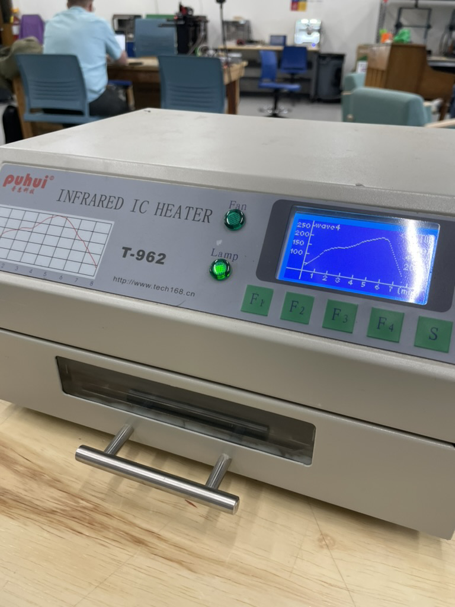
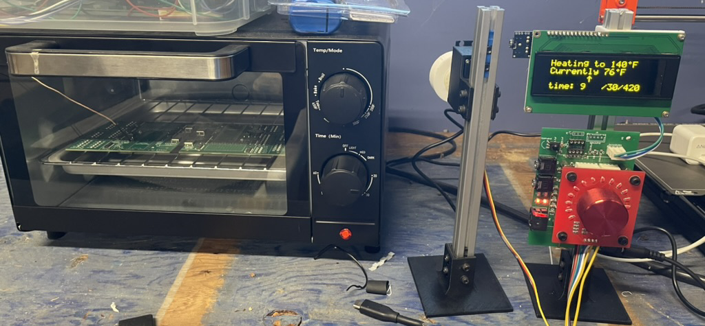
Cooking the circuit boards
This project gave me the perfect excuse to finally finish a project I’d had on hold for a while, making my own reflow oven out of a toaster oven, removing my dependence on the one in the makerspace

Slide 6
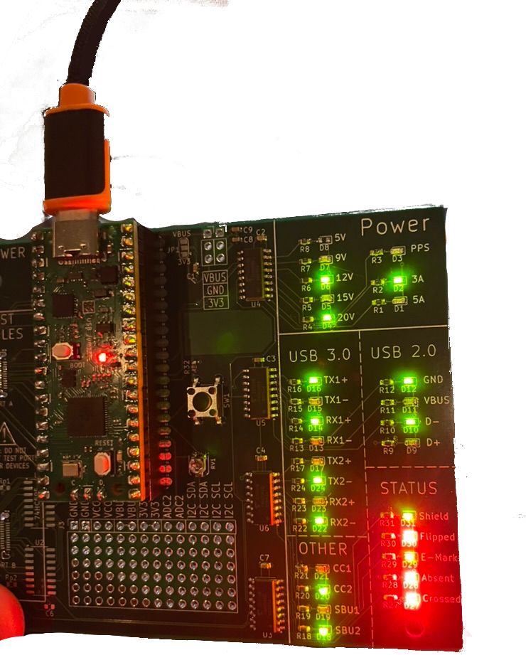
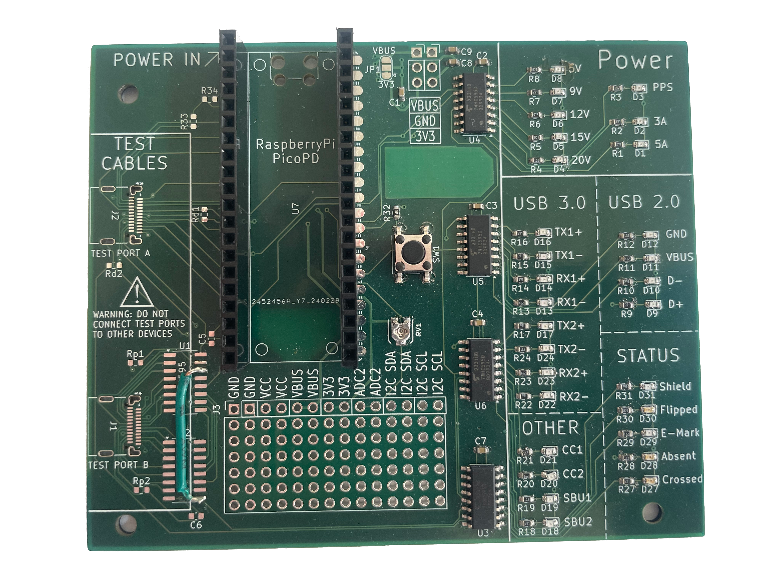
Board 1
LEDs worked great
Decided not to add USB C ports to first test device
“Green-wiring” required to workaround missing USB C port chips
Minor printing flaws too

Slide 7
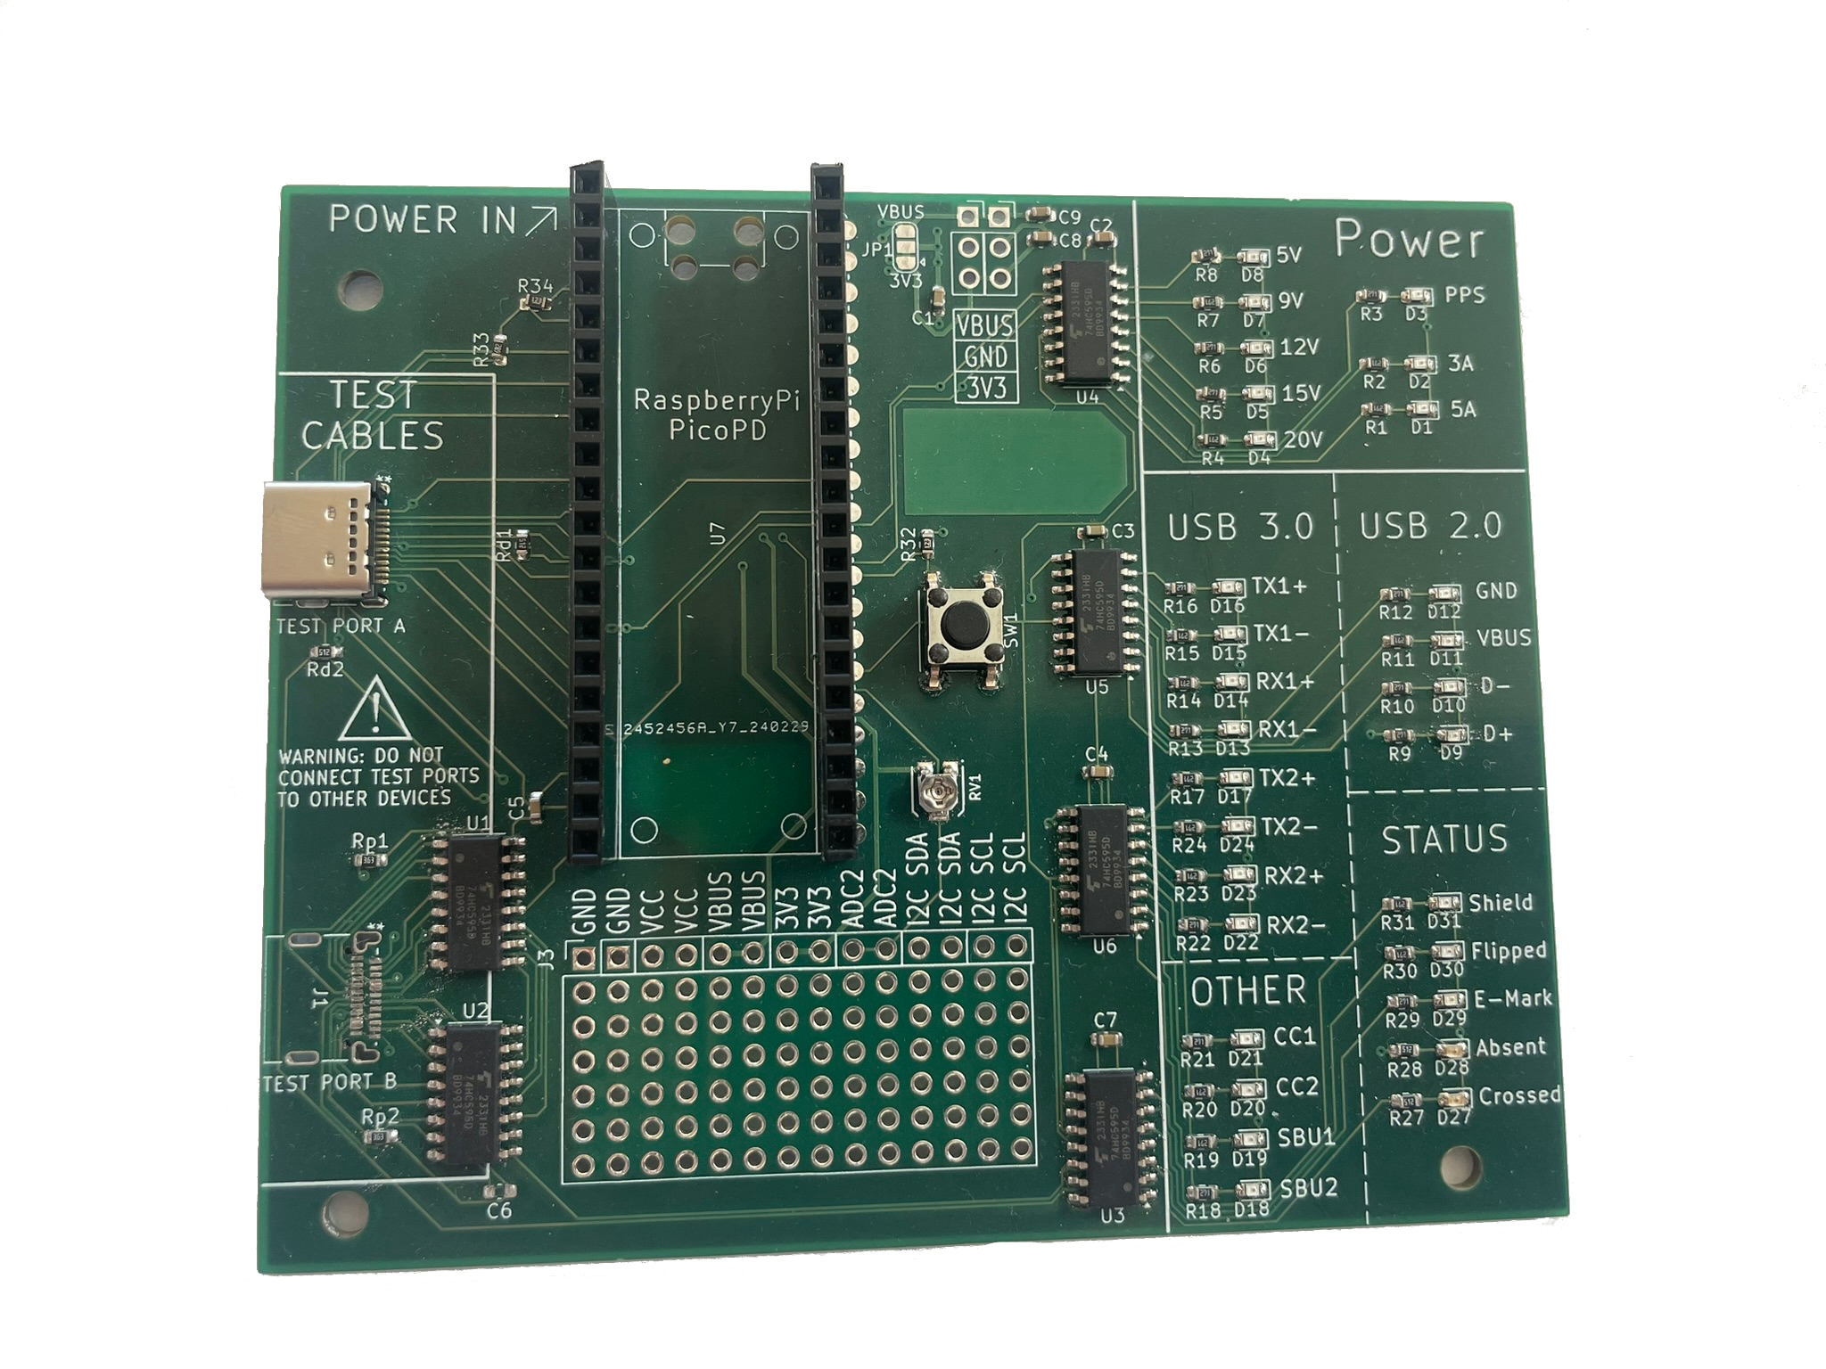
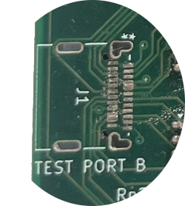
Board 2
Same design, second soldering attempt
Tried to solder USB C ports too
Some pins shorted
Port broke off
Turns out Soldering 24 pin USB C ports is hard!

Slide 8
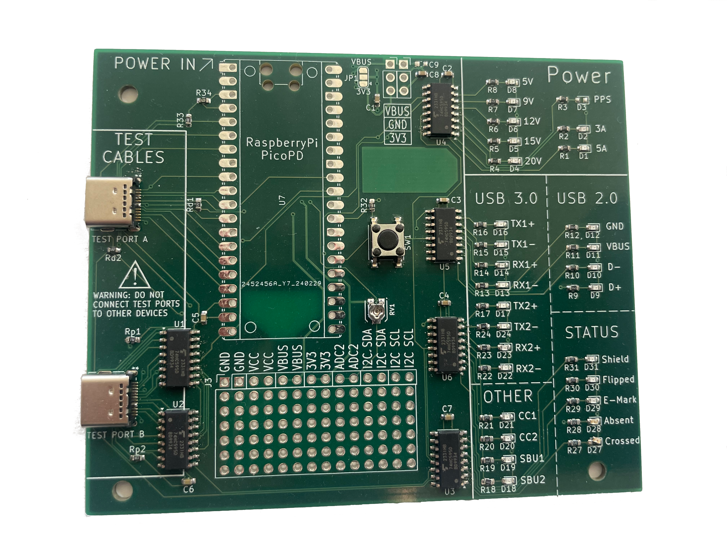
Board 3
Again, the small USB C Port connections had shorts between pins and wasn’t usable
Clearly a different approach was needed...

Slide 9
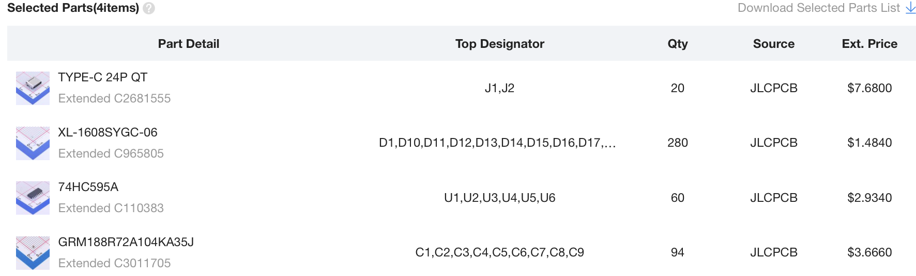
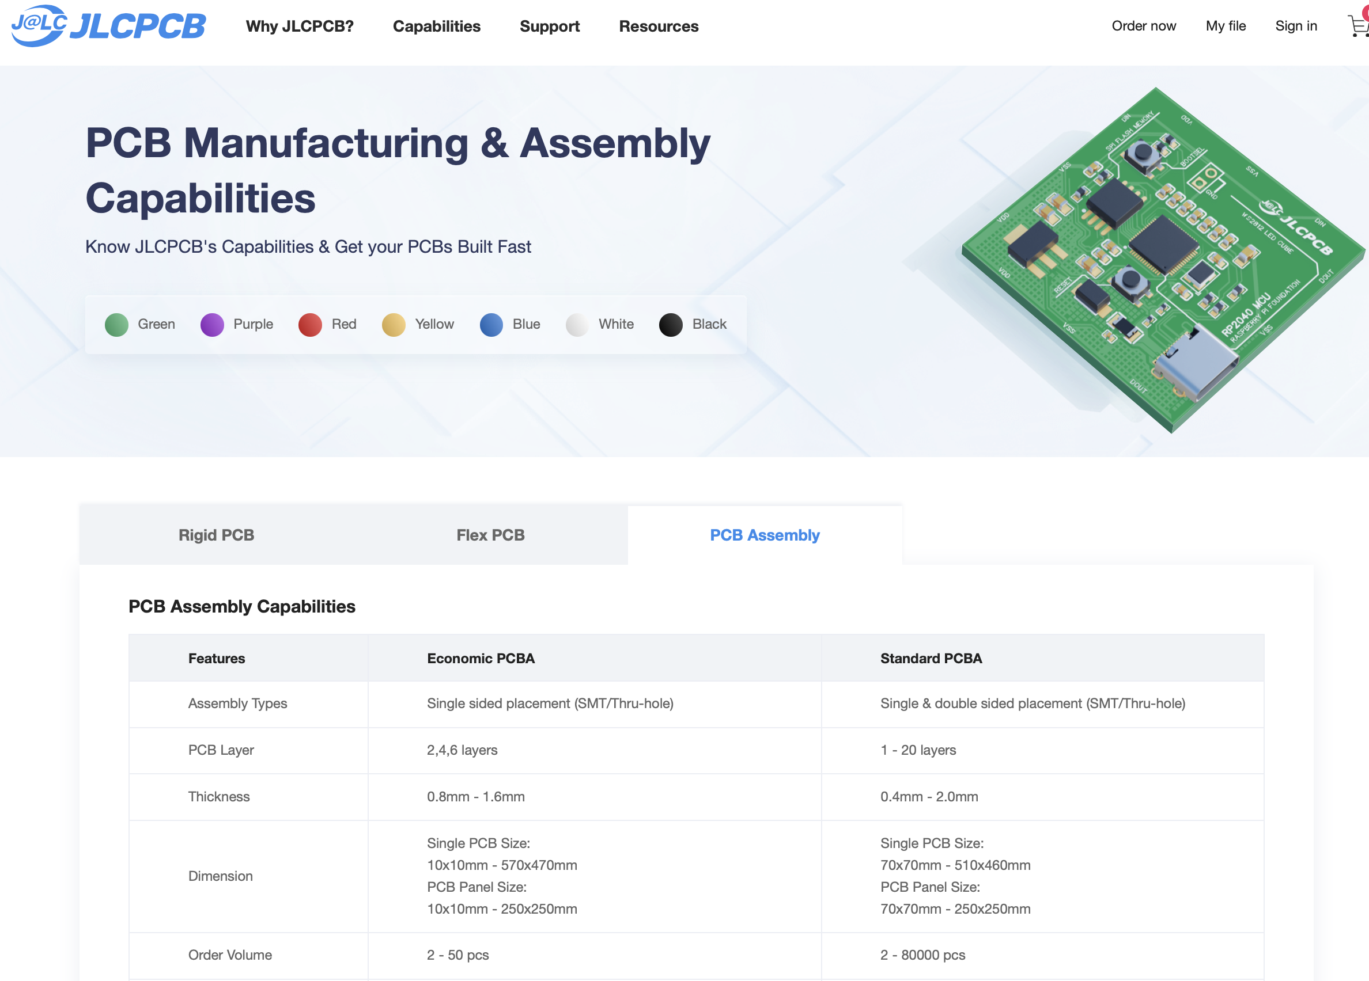
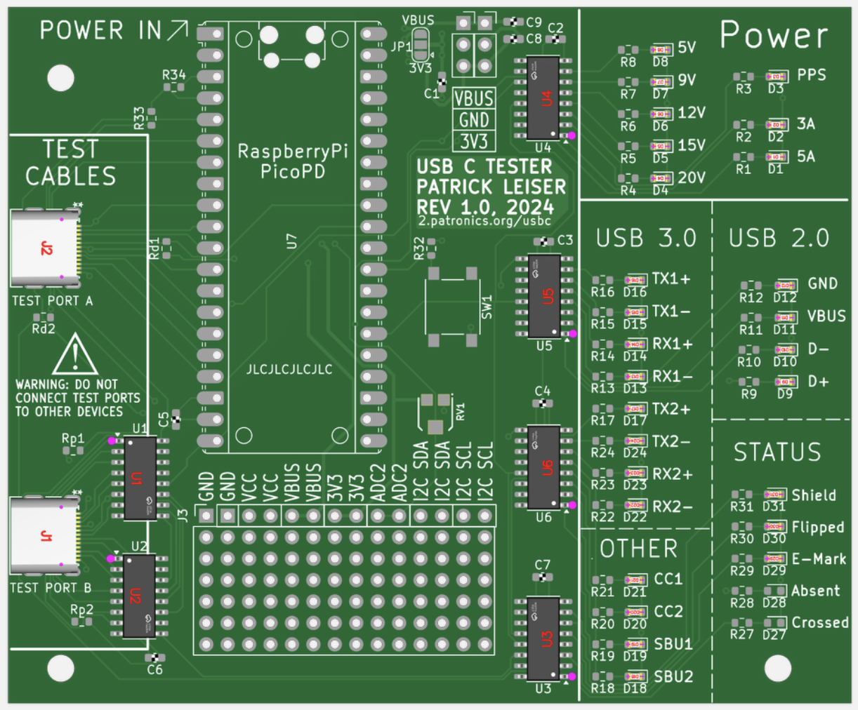
Solution: Pay JLCPCB to make them for me!

Slide 10
Board 4/5: New Problems
Boards with presoldered components arrived
These presoldered components were chosen from LCSC’s parts catalog, so may not be identical but should be equivalent to the parts in the first set of prototypes
But there’s a new problem
LEDs don’t work! Neither do the new ports!
Why??

Slide 11
Time to do lots of testing, and dig into the datasheets
All signals to the shift registers seemed to be transmitted fine
But the shift registers we never outputting a high signal to the LEDs or other outputs?
The datasheet indicated some features were missing (NC pins on next slide) on this shift-register variant, but those missing features could be worked around, that wasn’t the issue
Datasheets also weren’t exactly the most legible...

Slide 12
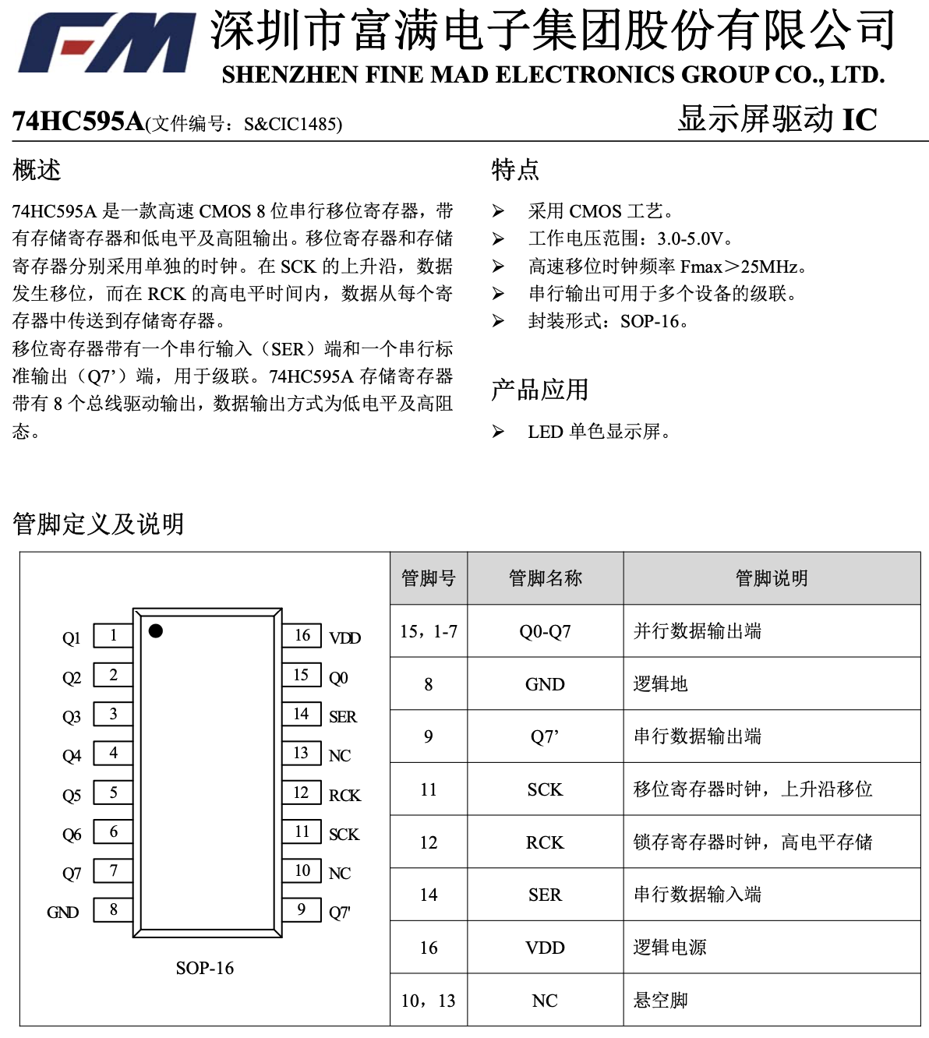
Unfortunately, I can’t read Chinese, and the website made it difficult to download a PDF to autotranslate. We’ll come back to this

Slide 13
Finally, a breakthrough discovery:
When the shift register outputs were commanded low, the voltage measured between the output pins and ground was 0v (as expected), and the voltage between the output pin and the +3.3V supply was 3.3V, also as expected. However, measuring when the outputs were commanded high revealed that the voltage between BOTH ground to the output pin and +3.3V to the output pin were reporting as 0V!
Thinking about this unexpected result revealed the likely cause, which examining the translated manual confirmed

Slide 14
Translation of the datasheet’s summary
74HC595A (file number: S&CIC1485) Overview 74HC595A is a high-speed CMOS 8-bit serial shift register with storage registers and low-level and high-impedance output. The shift register and the storage register use separate clocks. At the rising edge of SCK, the data shifts, and in the high-level time of RCK, the data is transmitted from each register to the storage register. The shift register has a serial input (SER) end and a serial standard output (Q7') end for cascading. The 74HC595A storage register has 8 bus drive outputs, and the data output mode is low level and high resistance. The characteristics of the display drive IC adopt the CMOS process. Operating voltage range: 3.0-5. OV. High-speed shift clock frequency Fmax>25MHz. Serial output can be used for cascade of multiple devices. Encapsulation form: SOP-16. The product applies LED monochrome display.
Can you see the problem?

Slide 15
Translation of the datasheet’s summary
74HC595A (file number: S&CIC1485) Overview 74HC595A is a high-speed CMOS 8-bit serial shift register with storage registers and low-level and high-impedance output. The shift register and the storage register use separate clocks. At the rising edge of SCK, the data shifts, and in the high-level time of RCK, the data is transmitted from each register to the storage register. The shift register has a serial input (SER) end and a serial standard output (Q7') end for cascading. The 74HC595A storage register has 8 bus drive outputs, and the data output mode is low level and high resistance. The characteristics of the display drive IC adopt the CMOS process. Operating voltage range: 3.0-5. OV. High-speed shift clock frequency Fmax>25MHz. Serial output can be used for cascade of multiple devices. Encapsulation form: SOP-16. The product applies LED monochrome display.
Can you see the problem?

Slide 16
Translation of the datasheet summary
74HC595A (file number: S&CIC1485) Overview 74HC595A is a high-speed CMOS 8-bit serial shift register with storage registers and low-level and high-impedance output. The shift register and the storage register use separate clocks. At the rising edge of SCK, the data shifts, and in the high-level time of RCK, the data is transmitted from each register to the storage register. The shift register has a serial input (SER) end and a serial standard output (Q7') end for cascading. The 74HC595A storage register has 8 bus drive outputs, and the data output mode is low level and high resistance. The characteristics of the display drive IC adopt the CMOS process. Operating voltage range: 3.0-5. OV. High-speed shift clock frequency Fmax>25MHz. Serial output can be used for cascade of multiple devices. Encapsulation form: SOP-16. The product applies LED monochrome display.
Can you see the problem?
The output is either Low level or High Resistance
We generally call this “High Impedance” rather than High Resistance.
It’s open drain, no ability to pull the output high!

Slide 17
A hacky workaround
Not content to give up on these boards yet (this was already the second $100+ batch), I brainstormed potential solutions
If I could pull up the output signals externally from the shift registers, it should still work
How to do that, within the existing constraints of the board design?

Slide 18
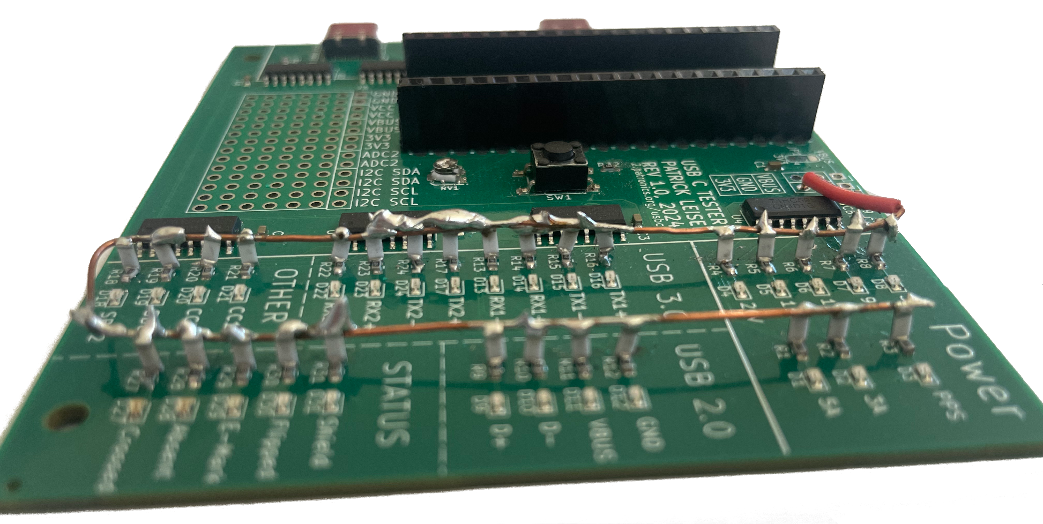
A hacky workaround
How to do that, within the existing constraints of the design?
Inspired by overhead power lines, I used leftover large surface-mount resistors from a previous project as pull-up resistors for the LEDs. This worked surprisingly well!

Slide 19
Revision 1.1 (The third batch)
Unfortunately, the power-line inspired approach worked for the LEDs but not for the small connections for the USB C port, so another board revision was still required, this time with the exact same shift registers as the first generation board used (costing a whole $0.15 more per chip)
I was able to do some basic testing with the 2nd batch despite the limitations, and found a few tweaks needed for the third board revision.
These tweaks needed an additional shift register to drive a few more outputs, so the third batch of boards have that addition as well, with a few extra pins exposed for future use.

Slide 20
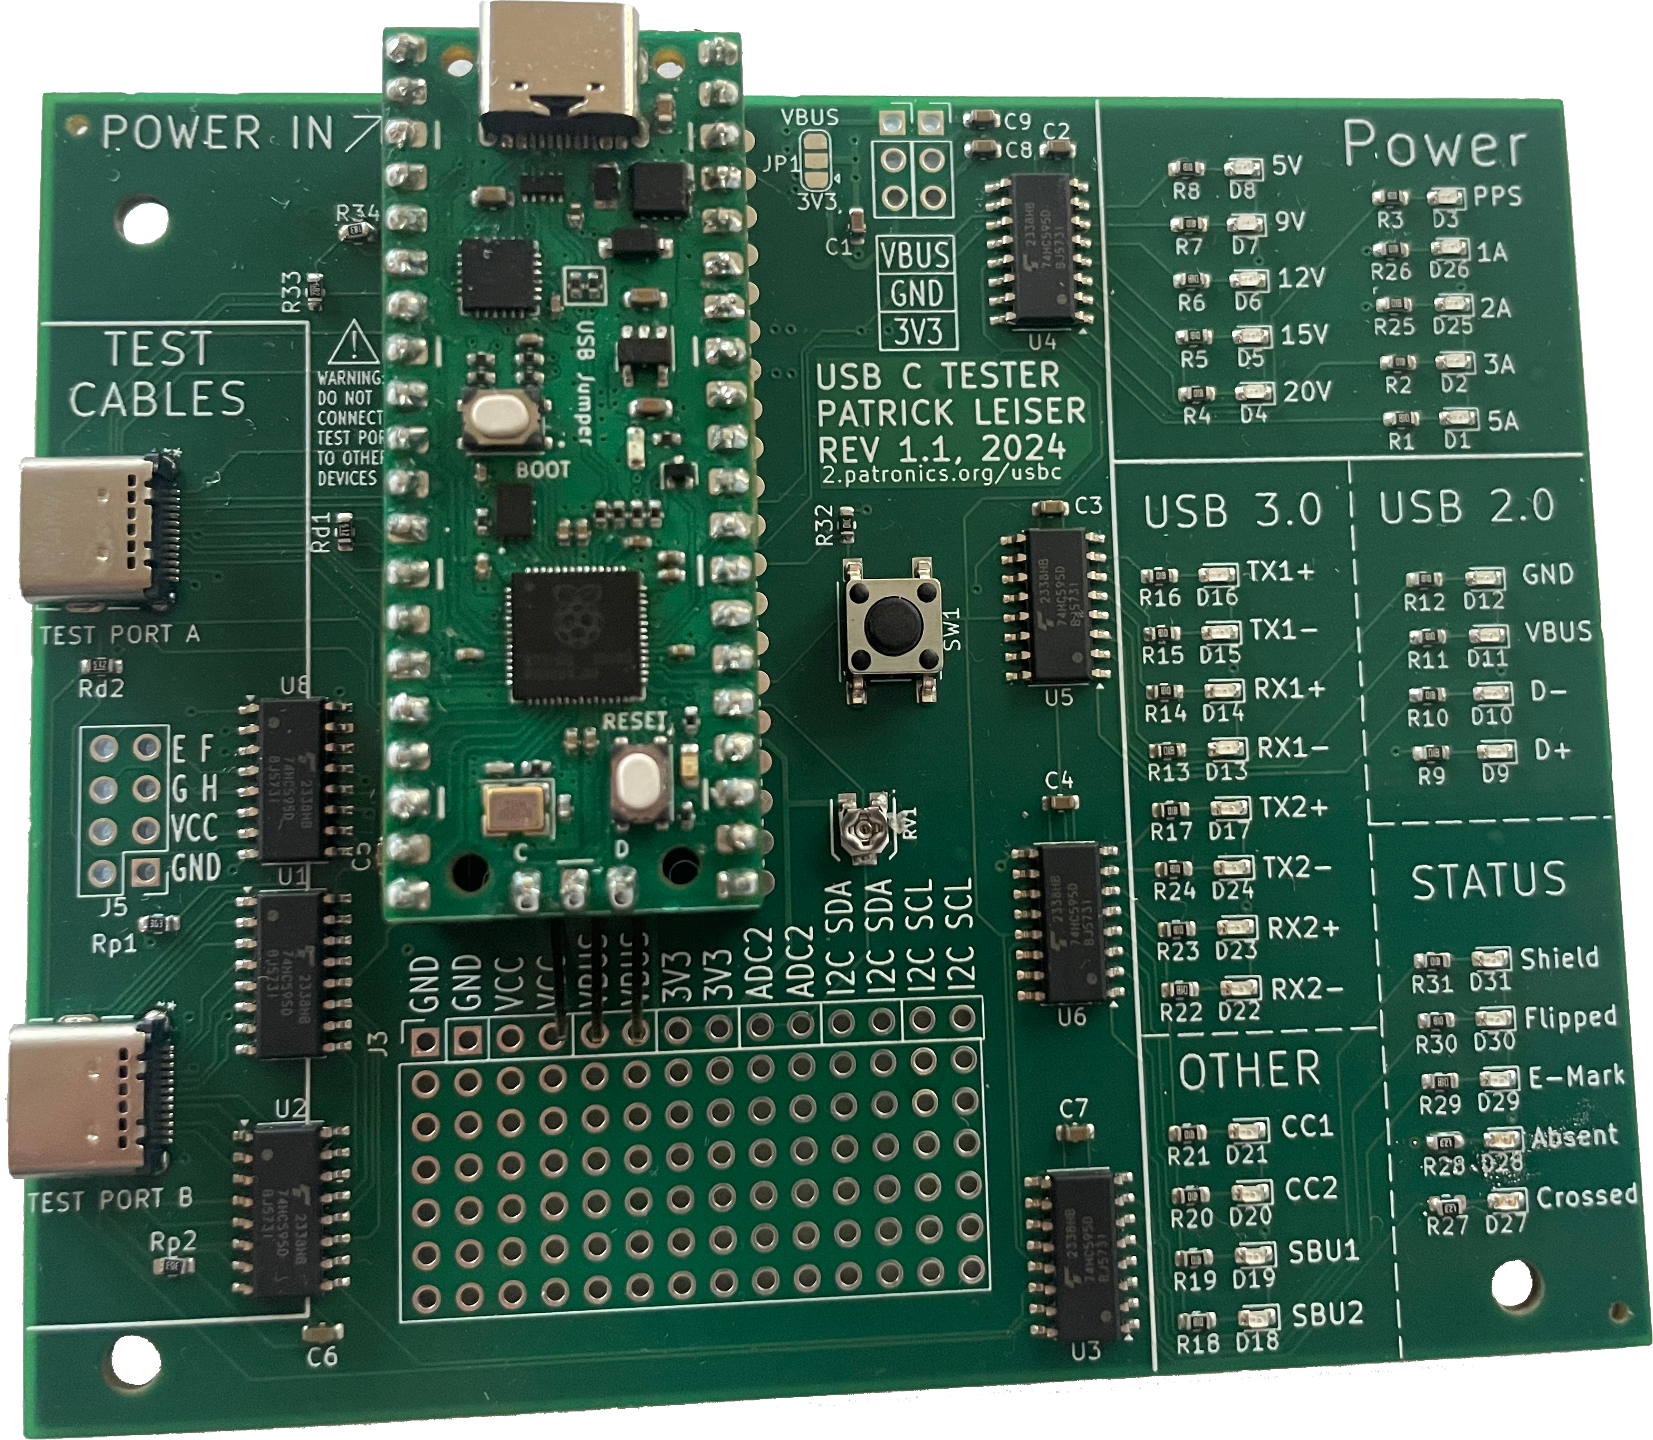
Revision 1.1 (The third batch)
Works great!
Just had to write the code to actually do the test of each pin

Slide 21

The Code
The final version of the code turned out to be around 590 lines long, much too long to reproduce here.
You can access it, along with the hardware design files (and this presentation) on my Github, at github.com/Patronics/USBC-Tester

Slide 22
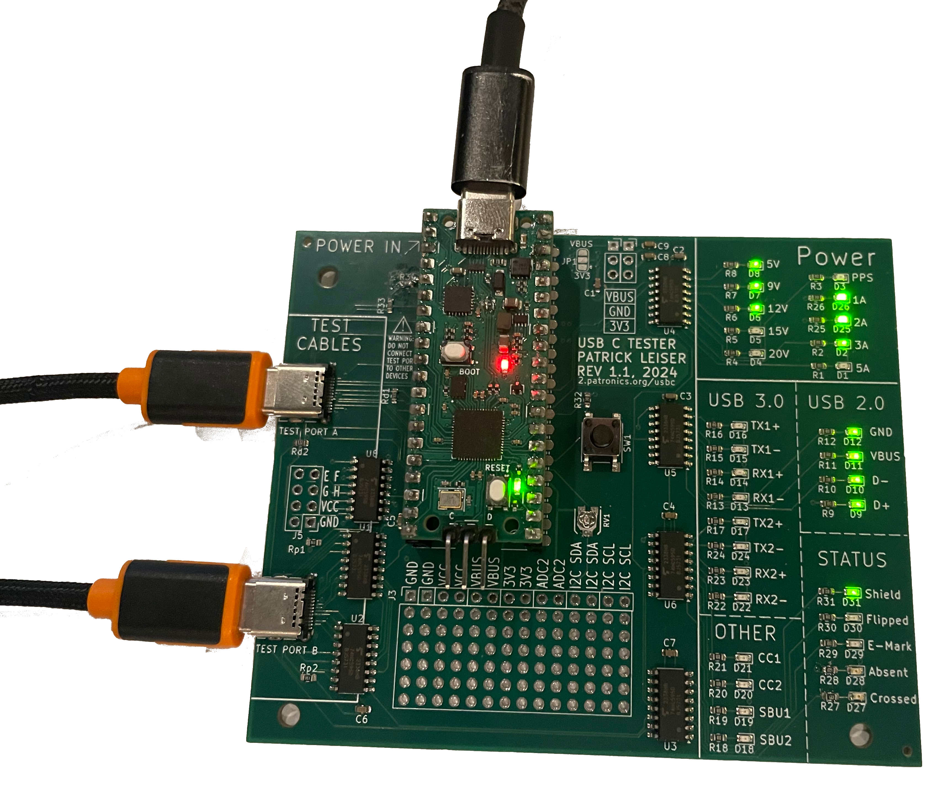
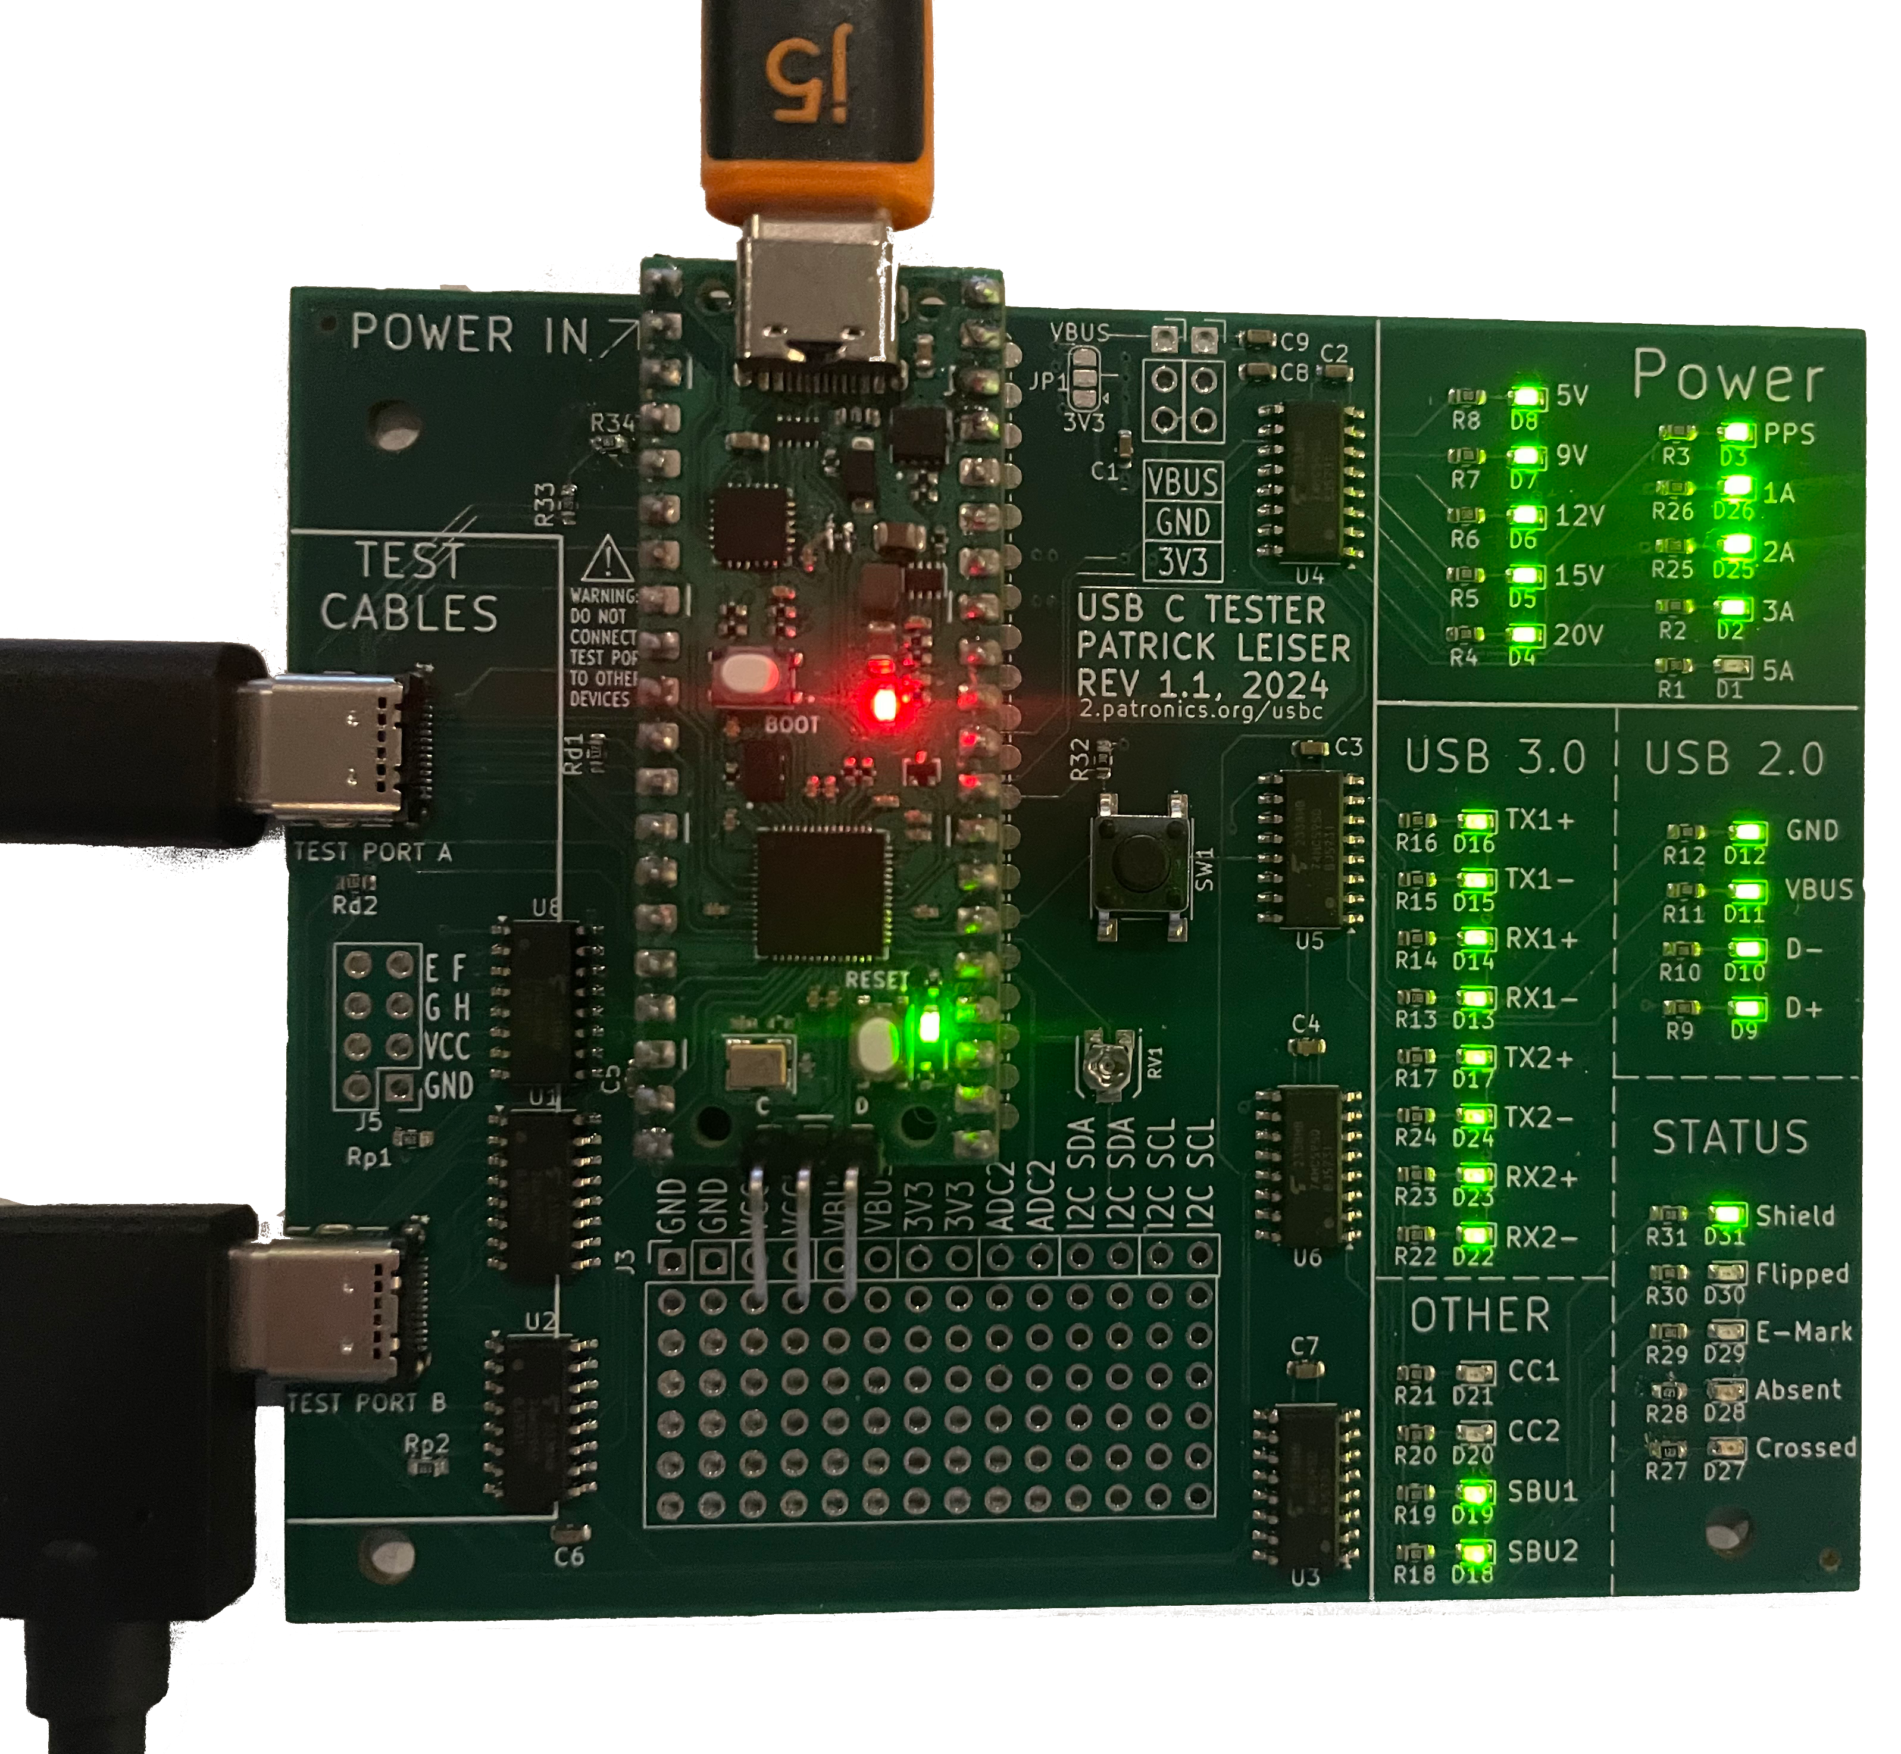
Results
It works really well!
It works really well!
Testing a 20W power supply and a USB-C cable that only supports USB2.0
Testing a 60W power supply and full-featured USB-C cable

Slide 23
In the interest of time I’m not going to cover these additional challenges and details in depth, but any questions are welcome :)
High – impedance output mode for the good shift registers
The two “Zones” I used for that, and how that split was essential for testing the USB Ground and Shield pins
Timing and voltage drop challenges
One particular cable seemed to indicate power was disconnected in my tests, when that cable clearly worked with other devices, I needed to increase time delays and substitute a pull-down resistor to fix this
Adding features to the upstream Power Delivery library to add the ability to test current limits at each voltage level
“Soft-Bricking” my Pi Pico, and designing my own PicoProbe boards to enable easier debugging of this and similar issues in the future
And etching the first one of these PicoProbe boards on my CNC machine

Slide 24
In the interest of time I’m not going to cover these additional challenges and details in depth, but any questions are welcome :)
Daisy-chaining the shift registers
Programmatically converting the hardware order of pins to more friendly software-order
Focusing on abstraction and overloading to simplify code
Protecting against common misuse of connecting to wrong USB port with voltage dividers
Designing with future projects in mind
button and potentiometer included for use as a configurable USB PD power supply
Prototyping board space at the bottom, and with breaking out available I/O and power pins
Displaying software version information at boot to disambiguate between boards

Slide 25
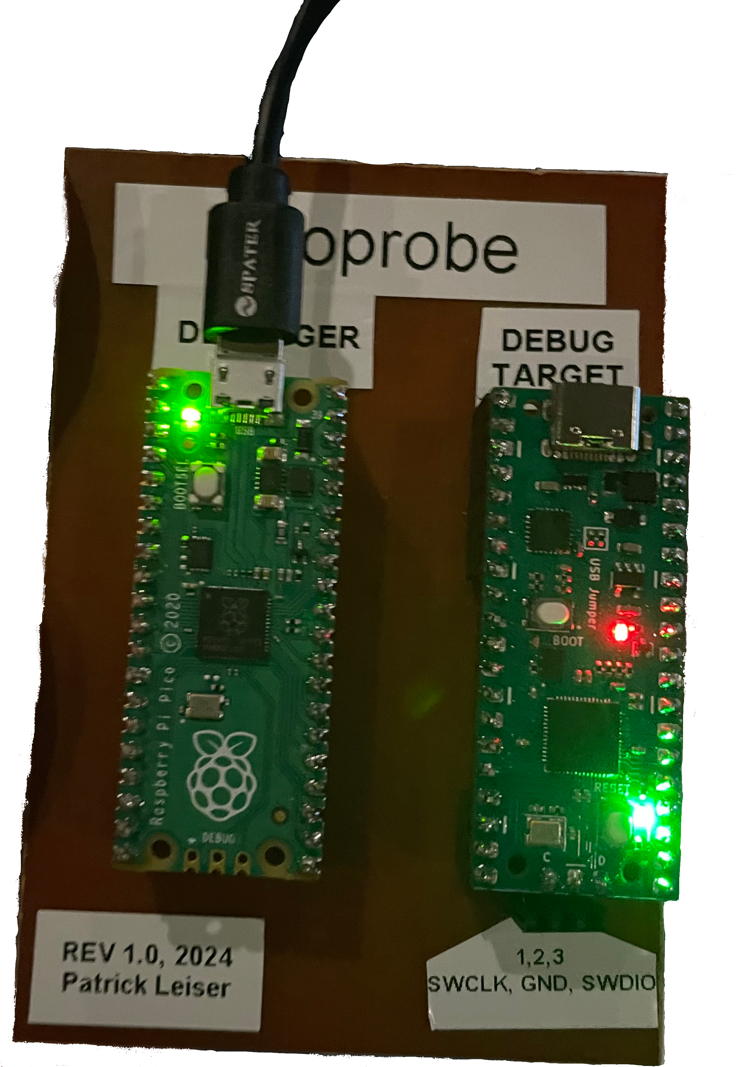
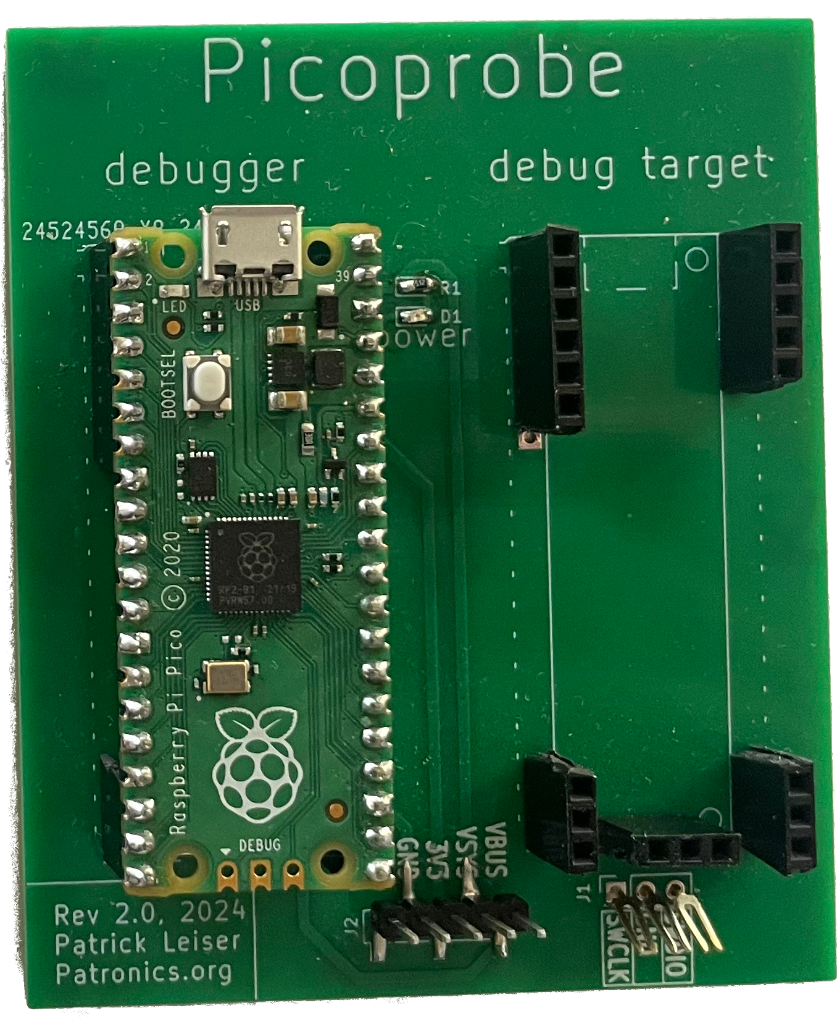
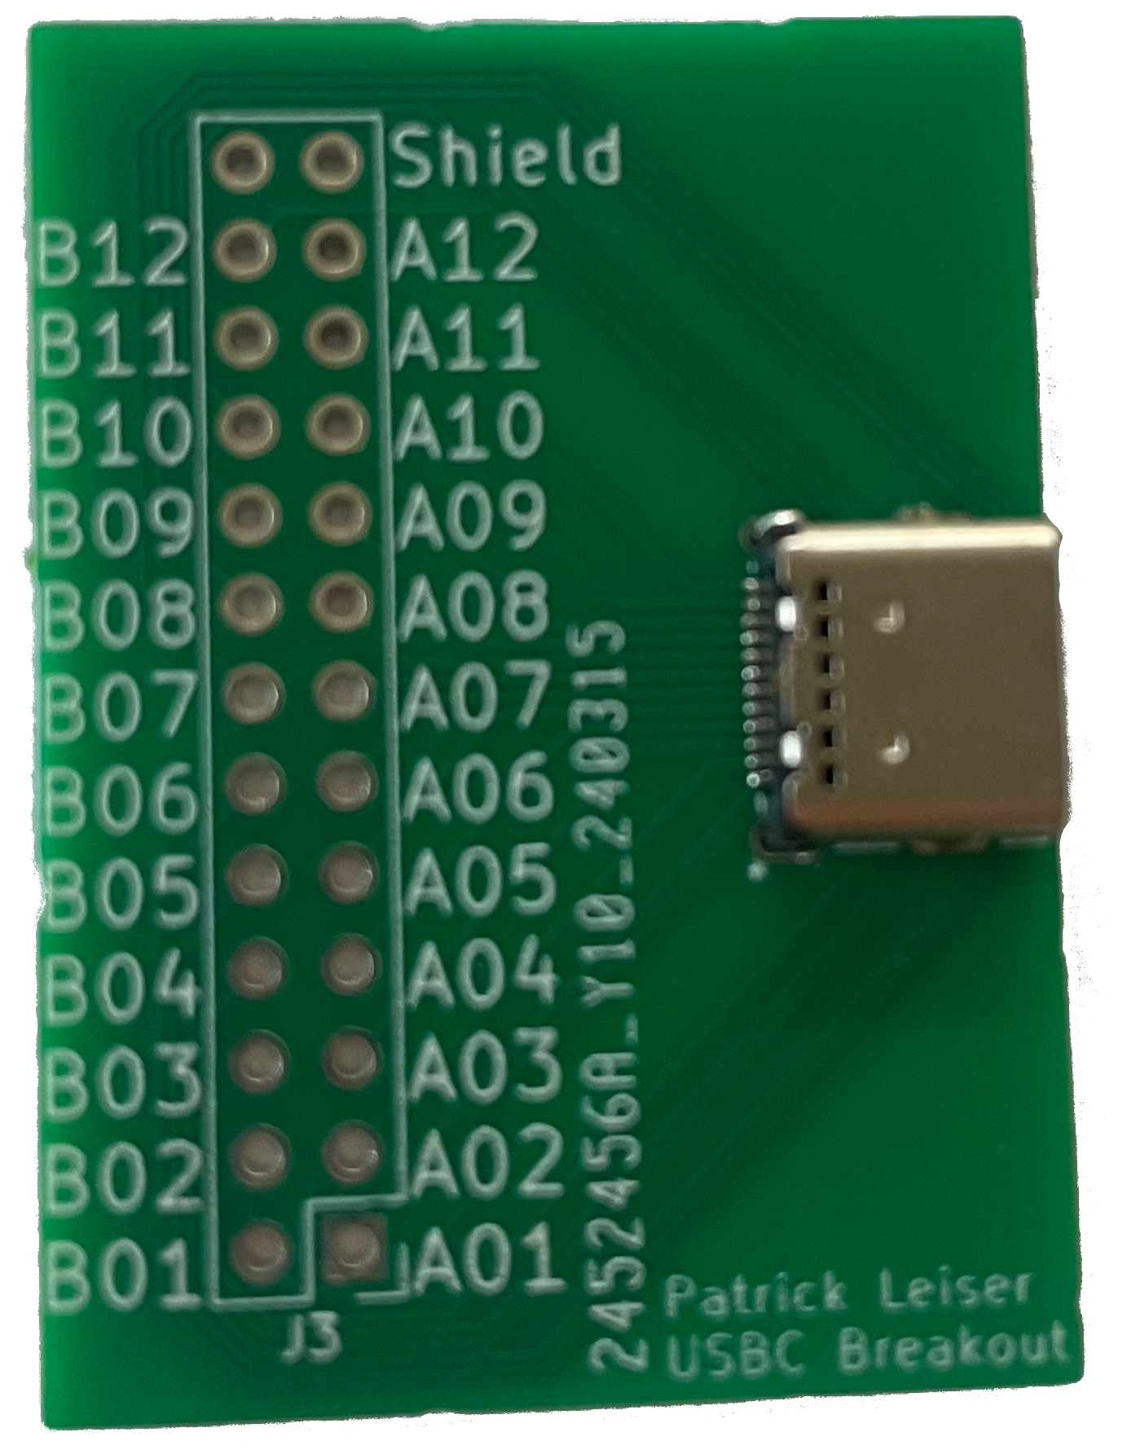
Other boards I designed to help with the project
PicoProbe Board
USB C Breakout
PicoProbe Debugging Board

